Slide 1
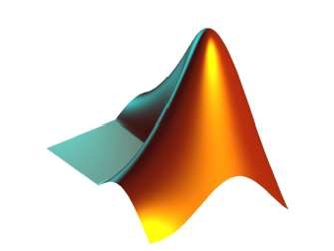
APPLICATIONS OF
MATLAB IN ENGINEERING
Yan-Fu Kuo
Dept. of Bio-industrial Mechatronics Engineering
National Taiwan University
Today:
Fall 2015
•
•
•
Image thresholding
Background image estimation
Component-connected labeling

Slide 2
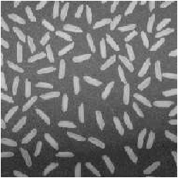
Applications of MATLAB in Engineering
Y.-F. Kuo
2
Problem Setup
• Count the rice grains and identify their sizes in
this image
• What are your strategies?

Slide 3
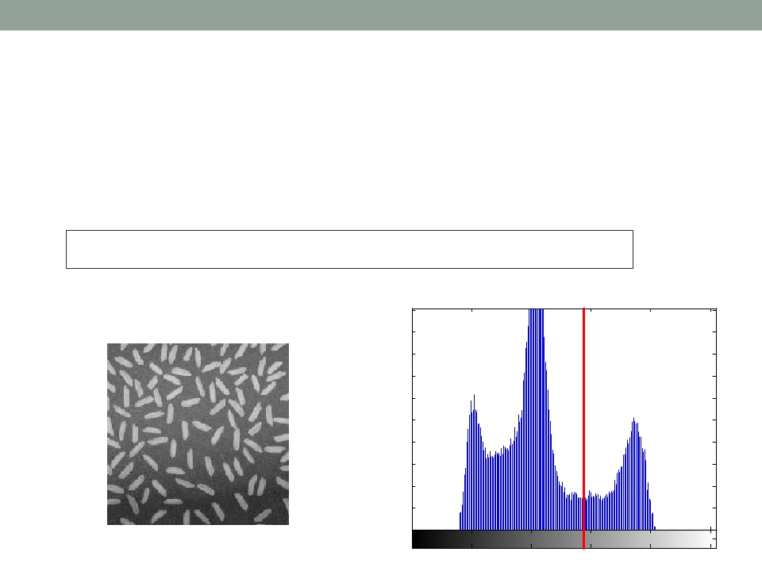
Applications of MATLAB in Engineering
Y.-F. Kuo
3
Image Thresholding
• A gray-level image can be turned into a binary image by
using a threshold
I = imread('rice.png'); imhist(I);
1000
900
800
700
600
500
400
300
200
100
0
0
50
100
150
200
250

Slide 4
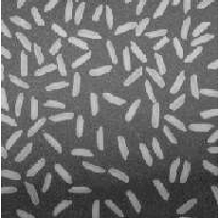
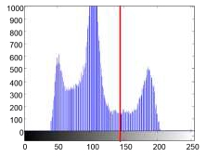
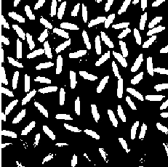
Applications of MATLAB in Engineering
Y.-F. Kuo
4
graythresh() and im2bw()
• graythresh() computes an optimal threshold
level
• im2bw() converts an images into binary image
I = imread('rice.png'); level=graythresh(I);
bw=im2bw(I, level); subplot(1,2,1); imshow(I);
subplot (1,2,2); imshow(bw);

Slide 5
Applications of MATLAB in Engineering
Y.-F. Kuo
5
Practice
• Write a program to convert the image rice.png
into a binary image using a threshold
• Do NOT use im2bw()
• Try different threshold values to see if you
program works

Slide 6
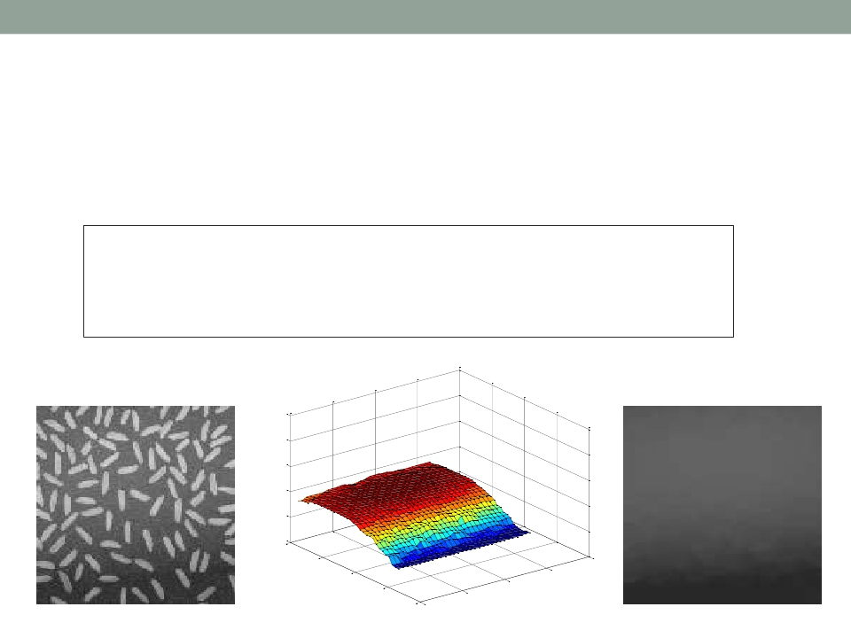
Applications of MATLAB in Engineering
Y.-F. Kuo
6
Background Estimation
• Estimation for the gray level of the background :
I = imread('rice.png');
BG = imopen(I, strel('disk', 15));
imshow(BG);
250
200
150
100
50
0
0
10
30
40
20
20
30
10
40
0

Slide 7
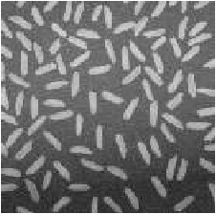

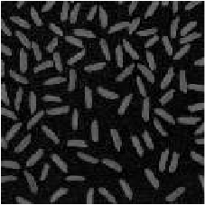
Applications of MATLAB in Engineering
Y.-F. Kuo
7
Background Subtraction
I = imread('rice.png');
subplot(1,3,1); imshow(I);
BG = imopen(I, strel('disk', 15));
subplot(1,3,2); imshow(BG);
I2 = imsubtract(I, BG);
subplot(1,3,3); imshow(I2);
-
=

Slide 8
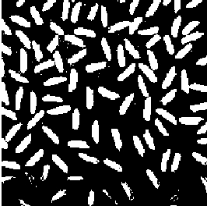
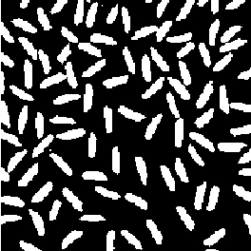
Applications of MATLAB in Engineering
Y.-F. Kuo
8
Thresholding on Background Removed Image
I = imread('rice.png'); level=graythresh(I);
bw = im2bw(I, level); subplot (1,2,1);
imshow(bw); BG = imopen(I, strel('disk', 15));
I2 = imsubtract(I, BG); level=graythresh(I2);
bw2 = im2bw(I2, level);
subplot(1,2,2); imshow(bw2);

Slide 9
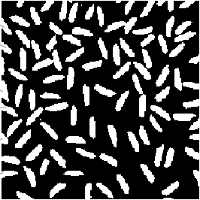
Applications of MATLAB in Engineering
Y.-F. Kuo
9
Now What?
• Want to identify how many grains there in the
image
• How?
#1
#2
#3
#4
#5
#6

Slide 10
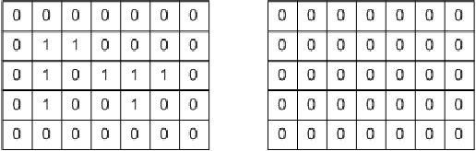
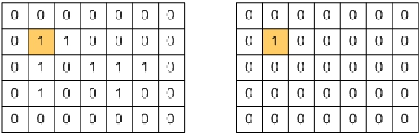
Applications of MATLAB in Engineering
Y.-F. Kuo
10
Connected-component Labeling
• A procedure for assigning a unique label to each
object
Binary image
Binary image
Label matrix
Label matrix
Step 1:

Slide 11
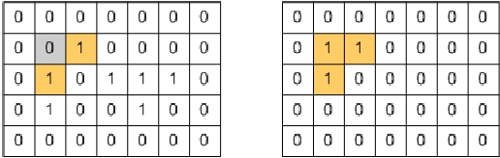
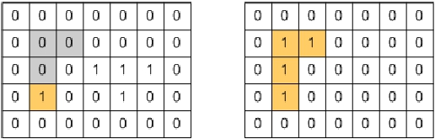
Applications of MATLAB in Engineering
Y.-F. Kuo
11
Connected-component Labeling (Cont’d)
• Finish labeling of a component
Binary image
Binary image
Label matrix
Label matrix
Step 2:
Step 3:

Slide 12
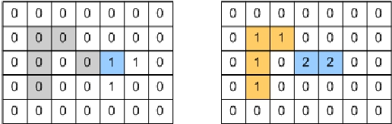
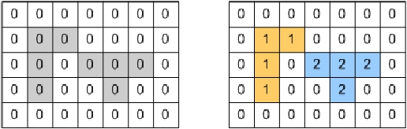
Applications of MATLAB in Engineering
Y.-F. Kuo
12
Connected-component Labeling (Cont’d)
• Iterative process until all the pixels are checked
Binary image
Binary image
Label matrix
Label matrix
Step 4:
Step 5:

Slide 13
Applications of MATLAB in Engineering
Y.-F. Kuo
13
Connected-component Labeling: bwlabel()
• Built-in connected-component labeling algorithm
I=imread('rice.png');
BG=imopen(I, strel('disk', 15));
I2=imsubtract(I, BG); level=graythresh(I2);
BW=im2bw(I2, level);
[labeled, numObjects]=bwlabel(BW, 8);
• Check the matrix labeled

Slide 14
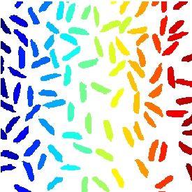
Applications of MATLAB in Engineering
Y.-F. Kuo
14
Color-coding Objects: label2rgb()
• Converts a label matrix into
an RGB color image
• Visualize the labeled regions
I=imread('rice.png');
BG=imopen(I, strel('disk', 15));
I2=imsubtract(I, BG); level=graythresh(I2);
BW=im2bw(I2, level);
[labeled, numObjects]=bwlabel(BW, 8);
RGB_label=label2rgb(labeled); imshow(RGB_label);

Slide 15
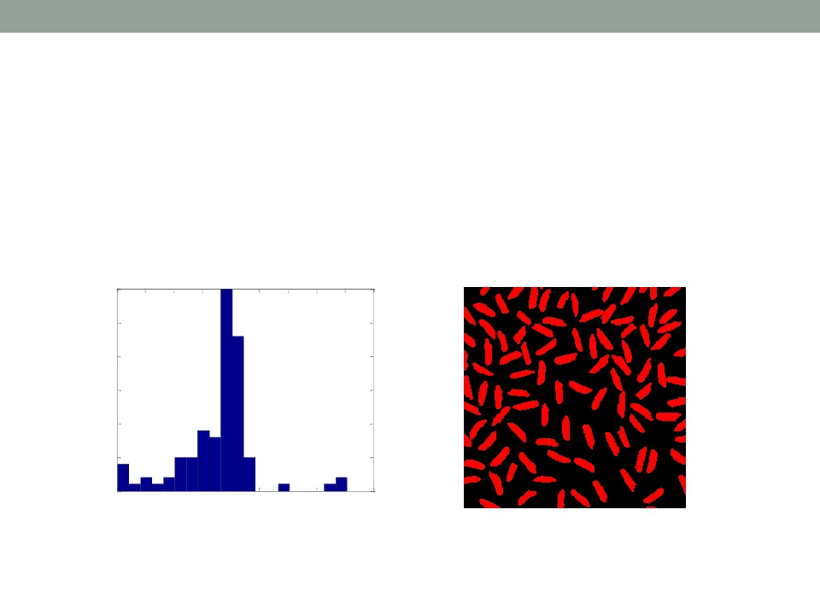
Applications of MATLAB in Engineering
Y.-F. Kuo
15
Practice
• Plot the histogram of grain size
• Identify all the grains in the image by painting
them in red
30
25
20
15
10
5
0
0
50
100
150
200
250
300
350
400
450
• Wait, is it perfect?

Slide 16
Applications of MATLAB in Engineering
Y.-F. Kuo
16
Object Properties: regionprops()
• Provides a set of properties for each
connected component
• Example:
I=imread('rice.png');
BG=imopen(I, strel('disk', 15));
I2=imsubtract(I, BG); level=graythresh(I2);
BW=im2bw(I2, level);
[labeled, numObjects]=bwlabel(BW, 8);
graindata = regionprops(labeled, 'basic');
graindata(51)

Slide 17
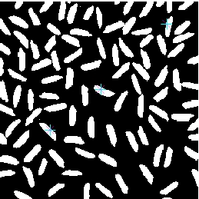

Applications of MATLAB in Engineering
Y.-F. Kuo
17
Interactive Selection: bwselect()
• Lets you select objects using the mouse
I=imread('rice.png'); level=graythresh(I);
BG=imopen(I, strel('disk', 15));
I2=imsubtract(I, BG); BW=im2bw(I2, graythresh(I2));
ObjI = bwselect(BW); imshow(ObjI);

Slide 18

Applications of MATLAB in Engineering
End of Class
Y.-F. Kuo
18

